Slide 1


UNeECC Annual Conference 2023
Cultur(E)scapes - Innovation in Culture and Beyond
27-29 September 2023
University of Pannonia - Veszprém, Hungary
CONFERENCE PROGRAMME

Slide 2
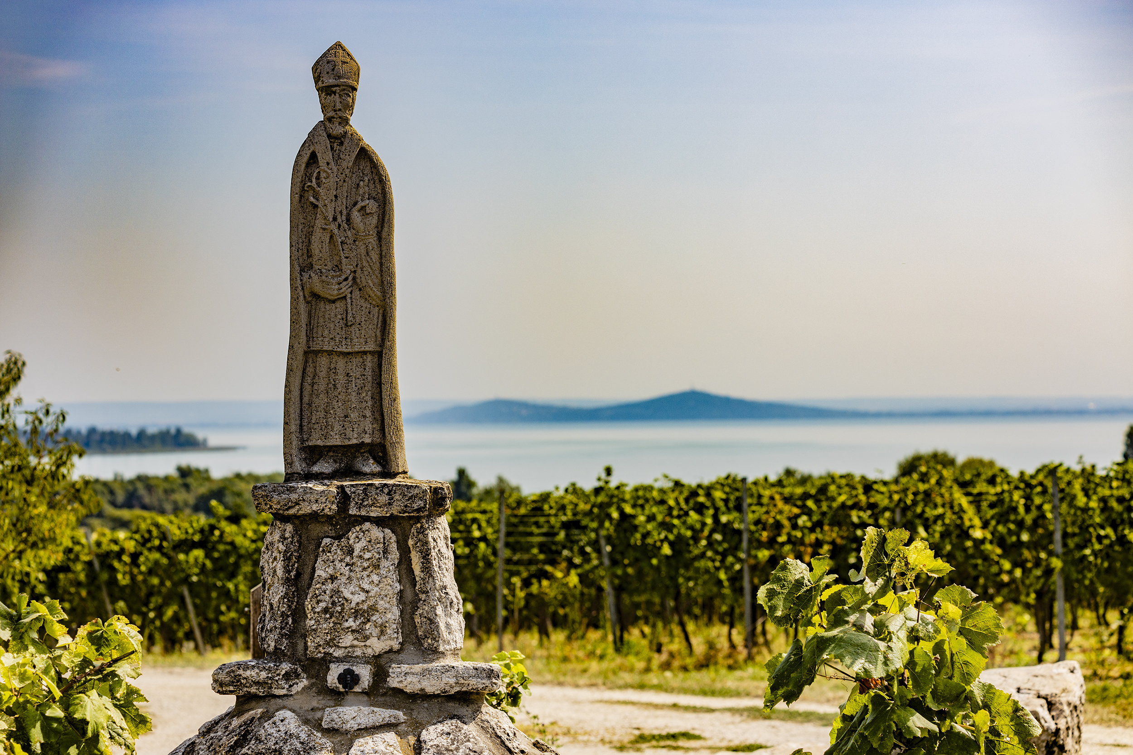
DAY 1 – 27 September 2023 | Place: Pannon Community Hub, University of Pannonia, Building E (8200 Veszprém, Egyetem u. 3.)
13:00-15:00 | Registration
15:00-18:00 Parallel events: | PhD workshop - public event | Monitoring Workshop - public event
Place: Pannon Community Hub - Community Room | PhD Workshop Programme: Moderator: Eszter Júlia Németh Chairs: William Chambers, László Imre Komlósi, Marco Valeri | Name | Institution | Title of presentation
 | 15:00 | William Chambers | Liverpool Hope University | How to become a successful young academic and how to publish in appropriate journals
 | 15:05 | Marco Valeri | Niccolò Cusano University | Publishing in international target journals
 | PhD Workshop presentations and discussions:
 | 15:15-15:30 | Alishan Karimov | University of Pannonia | Effect of the accommodation industry of Veszprém on the local stakeholders
 | 15:30-15:45 | Gabriela Michalecová | University of Pannonia | Relationships between ethics, trust and business success in the case of knowledge-oriented organisations
 | 15:45-16:00 | Katalin Júlia Dinnyés | University of Pécs | Values and health behaviour - The relationship between health culture and values system
 | 16:00-16:15 | Alena Nelaeva | Nord University | Social accountability in evaluating cultural mega projects? A case of the European Capitals of Culture
 | Further discussion
 | 17:45 | László Imre Komlósi | Széchenyi István University | Reflections and lessons from the workshop
 | 18:00 | PhD Workshop ends

Slide 3
Place: Pannon Community Hub - Project Room (E13) | ECoC Monitoring Workshop Programme Moderator: Dóra Kanizsai-Nagy | Name | Institution | Title of presentation
 | 15:00-15:05 | Welcome
 | Session 1
 | 15:05-15:15 | Dora Gomes | Politécnico de Leiria, IPleiria | ECoC Watch (CulTourData) - Supporting data-driven innovation for tourism SMEs in European Capitals of Culture
 | 15:15-15:25 | Rafaela Neiva Ganga | Liverpool John Moores University | Liverpool Boroughs of Culture – An Impact Analysis 2018-2022
 | 15:25-15:35 | Jacques Macquet | Esch2022 ASBL | Measuring the innovation-related impact of European Capital of Culture – case study of Esch2022
 | 15:35-15:45 | Judit Sulyok | University of Pannonia | ECoC is in the air – Impacts of the ECoC programme on the local university community
 | 15:45-15:55 | Dóra Kanizsai-Nagy | Veszprém-Balaton 2023 Zrt. | Data-driven Monitoring in the VEB2023 ECoC
 | Discussion
 | 16:15-16:40 | Coffee break
 | Session 2
 | 16:40-16:50 | Mervi Luonila | Center for Cultural Policy Research Cupore | Constructing a shared multi-level cultural policy: integrating European and local objectives in the context of Oulu2026
 | 16:50-17:00 | Olga Iermolenko | Nord University Business School | Social accountability in evaluating cultural mega-projects? A case of the European Capitals of Culture
 | 17:00-17:10 | Oliver Henk | Nord University Business School | The “People’s Jury” as new methodology for the evaluation of European Capitals of Culture: An experiment in Bodø (Nordland)
 | Discussion and closing remarks
 | 18:00 | Monitoring Workshop ends
18:00-20:00 | Buffet reception (for the registered participants of the PhD Workshop and the Monitoring Workshop)
20:00 | End of conference DAY 1

Slide 4
DAY 2 – 28 September 2023 | UNeECC Conference Opening | Place: University of Pannonia, Building B, 2nd Floor, Conference Hall (8200 Veszprém, Egyetem u. 10.)
8:00-8:45 | Registration
9:00-9:05 | Welcome | Edit Kővári, UNeECC General Secretary
9:05-9:30 | Opening speeches | János Abonyi, Vice-Rector for General and Scientific Affairs, University of Pannonia Friderika Mike, VEB2023 ECoC, programme development director Flora Carrijn, President of UNeECC
9:30-10:00 | Plenary session - Keynote speakers | Nico Degenkolb,Goethe-Institute, Munich (Germany), Interim Action Programme Director at EIT Culture & Creativity
10:05-10:35 |  | Zoltán Mészáros, Veszprém-Balaton 2023 ECoC, chief advisor
10:40-11:00 | Coffee break
 | Sessions
28 September | Shared cultural responsibilities | Place: University of Pannonia, Building B, 2nd Floor, Conference Hall (8200 Veszprém, Egyetem u. 10.)
11:00-12:30 | Chair: László Imre Komlósi | Name | Instituion | Title of presentation
 | 11:00-11:20 | Candy Fresacher | free lance | Creating a more inviting cultural landscape through positivity
 | 11:20-11:40 | Alishan Karimov | University of Pannonia | Effect of the accommodation industry of Veszprem on the local stakeholders
 | 11:40-12:00 | Sathawattey Sadh | University of Pannonia | Student Perspective on the Quality of Pannonia University’s Library
 | 12:00-12:20 | Rafael Robina Ramírez and László Imre Komlósi (Session Chair) | Széchenyi István University | Widening the Scope: Enhancing ERASMUS Exchanges among UNeECC Universities
12:30-13:30 | LUNCH

Slide 5
28 September | Shared cultural responsibilities | Place: University of Pannonia, Building B, 2nd Floor, Conference Hall (8200 Veszprém, Egyetem u. 10.)
13:30-15:10 | Chair: William Chambers | Name | Institution | Title of presentation
 | 13:30-13:50 | Chris Baldwin | CCD Productions Ltd. | ECoCs - Finding the City Story - Citizen Centred Dramaturgy
 | 13:50-14:10 | Heléna Kolip | University of Pécs Education and Society Doctoral School of Education | Adult education in the field of early childhood education in Serbia and Hungary
 |  | Gréta Ábrahám
 | 14:10-14:30 | Georg Steiner | University of Passau | The change of a city through culture - when tourism becomes art
 | 14:30-14:50 | Ildikó Virág Neumanné | University of Pannonia | Attitudes towards the transition to a circular economy - results of a questionnaire
 | 14:50-15:10 | William Chambers (Session Chair) | Liverpool Hope University | The UK Cities and Boroughs of Culture Programmes: Emerging Critiques
15:15-15:35 | Coffee break

Slide 6
28 September | Land(E)scape in tourism | Place: University of Pannonia, Building B, 2nd Floor, Conference Hall (8200 Veszprém, Egyetem u. 10.)
15:40-17:20 | Chair: Tamara Rátz | Name | Institution | Title of presentation
 | 15:40-16:00 | Ralf Wagner | University of Kassel | Glocal wine tourism: A Thirst for Cultural and Natural Exploration
 |  | Swati Singh | Vivekanand Education Society's Institute of Management Studies & Research
 | 16:00-16:20 | Ionel Samfira | University of Life Sciences "King Michael I" from Timisoara | Timisoara 2023 – an opportunity for sustainable tourism development in the Banat region
 | 16:20-16:40 | Katalin Lőrincz | University of Pannonia | Landscape-Based Tourism Development Towards Sustainability: A Case Study of the Balatonbike365 Project
 | 16:40-17:00 | Rasa Pranskunienė | Vytautas Magnus University | Landscape memories: the case of Observation towers
 | 17:00-17:20 | Tamara Rátz (Session Chair) | Kodolányi János University | The potential appeal of Japanese gardens in the context of slow tourism

Slide 7
28 September | Cultural land(E)scape | Place: University of Pannonia, Building B, 2nd Floor, Small conference room 1 (8200 Veszprém, Egyetem u. 10.)
11:00-12:30 | Chair: Ábel Szalontai | Name | Instituion | Title of presentation
 | 11:00-11:20 | Françoise Arfelli | Avignon University | The ochres massif: from an industrial landscape to a nature-based tourism : preservation and innovation
 | 11:20-11:40 | Brigitta Péterváry-Szanyi | Laczkó Dezső Múzeum | Hidden landscapes in County Veszprém - the Roman Heritage under our feet
 | 11:40-12:00 | Katalin Formádi | University of Pannonia | Landscape Attractions as Catalysts for Tourism Service Providers' Communication: A Study on Hotels near Major Scenic and Cultural Sites
 |  | Papp Zsófia Márta Papp | University of Pannonia
 |  | Eszter Madarász | University of Pannonia
 | 12:00-12:20 | Ábel Szalontai (Session Chair) | Moholy-Nagy University of Art and Design Budapest | MOME MAG and Landscape futuring
12:30-13:30 | LUNCH

Slide 8
28 September | Digital e-spaces in culture | Place: University of Pannonia, Building B, 2nd Floor, Small Conference Room 1 (8200 Veszprém, Egyetem u. 10.)
13:30-15:10 | Chair: Igor Mavrin | Name | Institution |  | Title of presentation
 | 13:30-13:50 | Anastassia Zabrodskaja | Tallinn University / Baltic Film, Media and Arts School |  | The Importance of Accessibility in Digital Communication
 | 13:50-14:10 | Mariana Cernicova-Buca | Politehnica University of Timisoara |  | Communicating cultural events – challenges in the digital age
 |  | Adina Palea
 | 14:10-14:30 | Fotimakhon Nazarova | Tashkent Institute of Finance |  | The importance of creating an information platform of the brand of national craft products in attracting tourists to the tourism industry
 | 14:30-14:50 | Yulduz Ergasheva | Karshi Engineering-Economics Institute |  | The use of digital technologies in the promotion of historical and cultural heritage and the development of tourism in Uzbekistan.
 | 14:50-15:10 | Igor Mavrin (Session Chair) | University in Osijek - Academy of Arts and Culture |  | Towards the (arche)types of virtual tourists - exploring the motivations for future virtual travels
 |  | Corina Turșie | West University of Timisoara
15:15-15:35 | Coffee break
28 September | Digital e-spaces in culture | Place: University of Pannonia, Building B, 2nd Floor, Small Conference Room 1 (8200 Veszprém, Egyetem u. 10.)
15:40-16:40 | Chair: Ildikó Virág Neumanné | Name | Instituion |  | Title of presentation
 | 15.40-16.00 | András Timár | University of Pécs Breuer Marcell Doctoral School |  | Reconstruction and presentation of the ruins of Aquincum using computer game engines
 | 16.00-16.20 | Mateja Kregar Gliha | University of Maribor- Faculty of Tourism |  | Communication of cultural attractions and heritage through online guided literary tours
 | 16.20-16.40 | Tamás Gyulai | Széchenyi István University of Győr, Doctoral School of Regional and Business Administration Sciences |  | Digitalisation in cities as European cultural capitals
17:20 | End of conference DAY 2
19:00 | Gala Dinner - Betekints Hotel and Restaurant |  |  | www.betekints.hu Address: 8200 Veszprém, Veszprémvölgyi u. 4.

Slide 9
DAY 3 – 29 September 2023 |  | Place: Laczkó Dezső Museum (8200 Veszprém, Erzsébet sétány 1.) www.ldm.hu
8:15-9:00 |  | Registration | Please register for Day 3 programmes in advance!
 |  |  | Registration link for Day 3: https://veb2023.typeform.com/to/AJJYVz4u
Session
9:00-10:40 | Shared Cultural Responsibilities
 | Chair: Flora Carrijn |  | Name | Institution | Title of presentation
 | 9:00-9:20 |  | Beáta Fehérvölgyi | University of Pannonia | Foster cultural responsibility through university innovation ecosystem Introduction of a Hungarian case during the European Cultural Capital period
 |  |  | Eszter Júlia Németh | University of Pannonia / GTK- Innovation management Institute
 | 9:20-9:40 |  | Henrietta Ködmönné Pethő | University of Pannonia | Subjective quality of life and emotional intelligence of the Hungarian population in the year of Veszprém-Balaton 2023 What can future ECoC city learn?
 | 9:40-10:00 |  | Éva Kruppa-Jakab | University of Pannonia | Citizens’ motivation and attitude as potential host volunteers in the preaparatory years of the Veszprém-Balaton 2023 European Capital of Culture Programme
 | 10:00-10:20 |  | Zsolt Szűrös | Széchenyi István University | BIM-based design and reconstruction of historical buildings - Innovative methods and future opportunities
 |  |  | Rita Rebeka Ördög
 | 10:20-10:40 |  | Flora Carrijn (Session Chair) | KU Leuven | Learn to talk, then walk the talk - Stimulating Creativity through Cognitive Identification and Terming based on a Taxonomy of the Relation Art-Innovation
10.40-11.00 | Coffee break
11:00-12:50 | Roundtable discussion
 | 11:00-12:20 |  | Roundtable discussion with the chairs and Rita Wahab, Head Of CEO's Cabinet Office at Veszprém-Balaton 2023 European Capital of Culture
 | 12:25-12:40 |  | Publication opportunities
 | 12:40-12:50 |  | Introducing UNeECC Conference venue Timisoara 2024
12:50-14:00 | LUNCH
14:00-15:00 | Visiting the exhibition in two groups / poster presentation and networking with coffee
15:15-17:15 | Veszprém, the musical jewellery box guided tour, Tour guide: Éva Kruppa-Jakab
17:15 | End of Conference DAY 3

Slide 10
POSTER PRESENTATIONS
Place: University of Pannonia, Building B, 2nd Floor, Conference Centre (8200 Veszprém, Egyetem u. 10.)
28 September | TV |  |  | Projector in Conference Room 2
 | Name | Institution | Title of poster presentation | Name | Institution | Title of poster presentation
10:45-10:55 | Lei Zhao | University of Pécs (Pécs, Hungary) | Place perception through the media of people, objects and space in the urban environment | Jacques Maquet | Esch2022 ASBL (Esch-sur-Alzette, Luxemburg) | Measuring the innovation-related impact of European Capital of Culture – case study of Esch2022
15:00-15:10 | - |  |  | Fatima Nazarova | Tashkent Institute of Finance (Tashkent, Uzbekistan) | The importance of creating an information platform of the brand of national craft products in attracting tourists to the tourism industry
Place: Laczkó Dezső Museum LDM (8200 Veszprém, Erzsébet sétány 1.)
29 September | LDM 1st floor Projector 1 |  |  | LDM 1st floor Projector 2
 | Name | Institution | Title of poster presentation | Name | Institution | Title of poster presentation
14:00-14:15 | Adina Palea | Politehnica University Timisoara (Romania) | Communicating cultural events – challenges in the digital age | Rasa Pranskunienė | Vytautas Magnus University (Kaunas, Lithuania) | Experiencing culture in a different way
14:20-14:35 | Gyulai Tamás | Széchenyi István University (Győr, Hungary) | Digitalisation in cities as European cultural capitals | Dinnyés Katalin Júlia | University of Pécs Education and Society Doctoral School of Education | The relationship between health culture and values system
14:40-14:55 | Georg Steiner | University of Passau (Germany) | The change of a city through culture - when tourism becomes art | -

Slide 11

For the detailed programme (including abstracts, key words, co-authors) please click on this link: https://docs.google.com/spreadsheets/d/18FKnvTIek-KuwqmTpwIccvT1Hy0lYyhP/edit#gid=38748624
The UNeECC Annual Conference 2023 titled 'Cultur(E)scapes Innovation in Culture and Beyond' is supported by the Veszprém-Balaton 2023 European Capital of Culture programme

